Slide 1
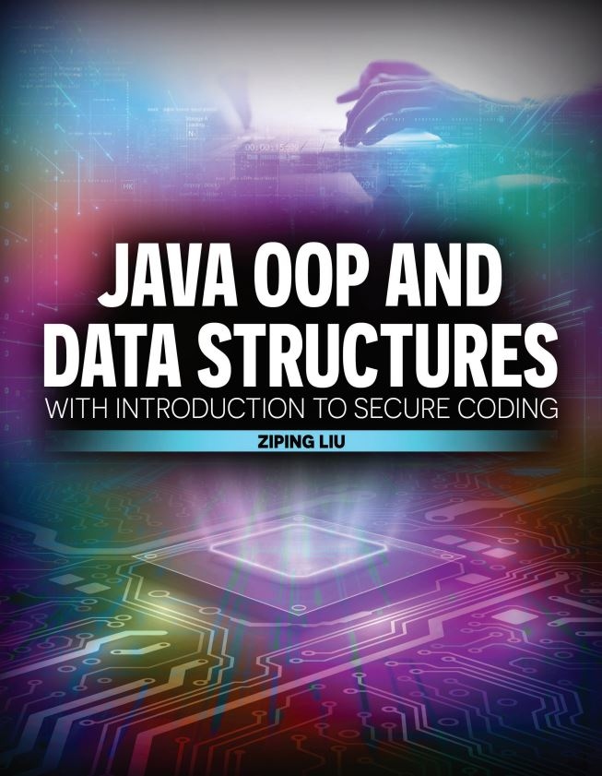

Slide 2

Java OOP and Data Structures with Introduction to Secure Coding Dr. Ziping Liu
Chapter 12 Stack

Slide 3
https://he.kendallhunt.com/product/java-oop-and-data-structures-introduction-secure-coding
Chapter 12 Stack

Slide 4

Chapter Outlines
What is a stack?
Implementing a capacity-bounded stack using an array
Implementing a capacity-unbounded stack using an array
Resizing an array to mimic unbounded capacity
Using stacks to calculate the base-n representation of an integer
Implementing the Iterable and Iterator interfaces for a stack
Using Stack<E> from the Java Collections
Advanced stack applications
Translating infix to postfix mathematical expressions
Solving the 8-Queen puzzle

Slide 5
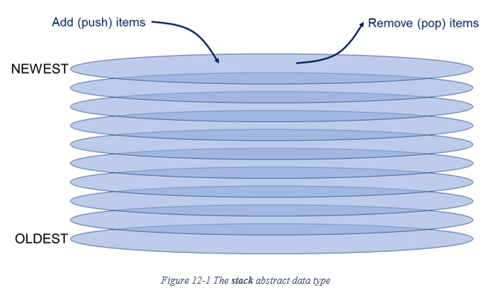
12.1 What is a Stack?
an ADT for an ordered collection of items that can only be accessed at one end—at the “top” of the stack
Users can interact with stacks through two operations:
push(item): add an item to the top of the stack;
pop(item): remove the item at the top of the stack if the stack has at least one element remaining

Slide 6
12.1 What is a Stack?
Stack memory - Java Virtual Machine Stack - runtime stack
a special reserved memory location
Whenever a method is invoked, including main(), Java creates a stack frame to store method-related information (e.g. method parameters and local variables, the method’s return address, and other temporary storage needs)
Java adds (“pushes”) the stack frame to the “top” of stack memory
when the method finishes executing, Java removes (“pops”) that method’s frame from the top of stack memory and destroys the frame
the frame at the top of the runtime stack is always the frame for the method—say, method1()—currently under execution

Slide 7
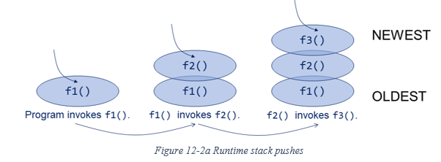
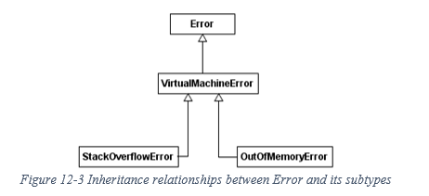
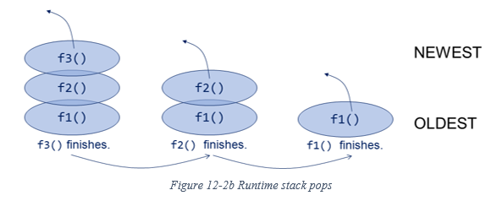
12.1 What is a Stack?
Stack memory - Java Virtual Machine Stack - runtime stack

Slide 8
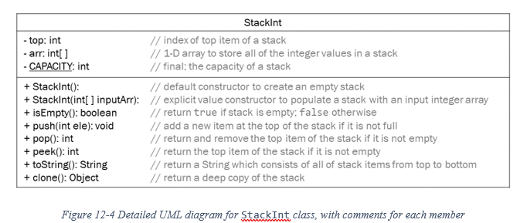
12.2 Implementing a Capacity-Bounded Stack Using an Array

Slide 9
12.3 Implementing a Capacity-Unbounded Stack Using an Array
make the arrays “resizable” and “grow” whenever we need more space
In our implementation, we double the array’s current size
To optimize the amount of memory we are using, we could shrink the size of the data array if the user begins removing items from the stack, and the additional space is no longer needed
halving the length of the underlying array if removing the topmost item from the stack would cause the height of the stack data structure to fall below 50% array capacity

Slide 10


Slide 11


Slide 12
12.4 Iterating through a Stack
Implementing Iterable for the stack class

Slide 13
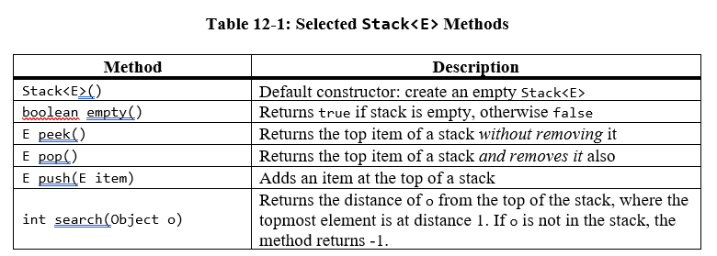
12.5 The Stack in Java Collections
In addition, the Stack class implements Cloneable and Iterable

Slide 14
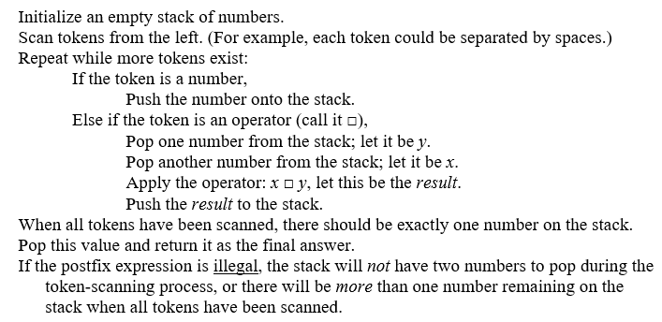
12.6 Advanced Stack Applications
Postfix Evaluation: 3 9 2 – 5 6 * + *

Slide 15
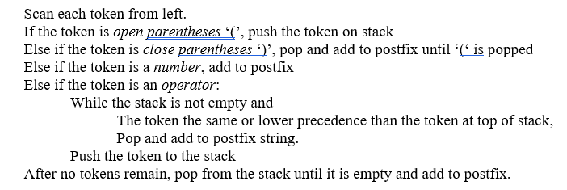
12.6 Advanced Stack Applications
Infix to Postfix Expression Conversion: (3 + 5) * 9 – 2 + 6

Slide 16
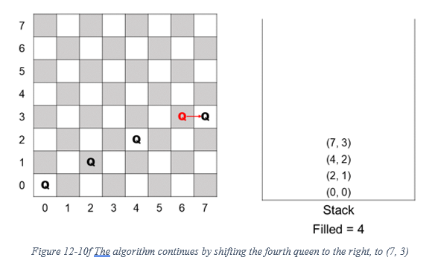
12.6 Advanced Stack Applications
The Eight-Queen Puzzle: backtracking

Slide 17
Which National Park is it?
Answer: Lassen Volcanic National Park

